Slide 1

BRAILLE-DRISTI
ब्रेल-दृष्टि
#The_new_visions_awaiting

Slide 2
PROBLEMS:
AVAILABILITY OF BOOKS ON BRAILLE
CAN’T SHARE THEIR CREATION
BLOCKADE FOR EDUCATION

Slide 3
SOLUTIONS
AUTOMATIC BRAILLE
TYPEWRITER
“ But even the price of a normal manual braille printer is too expensive. Small-volume braille printers cost between $1,800 and $5,000 and large-volume ones may cost between $10,000 and $80,000.”

Slide 4
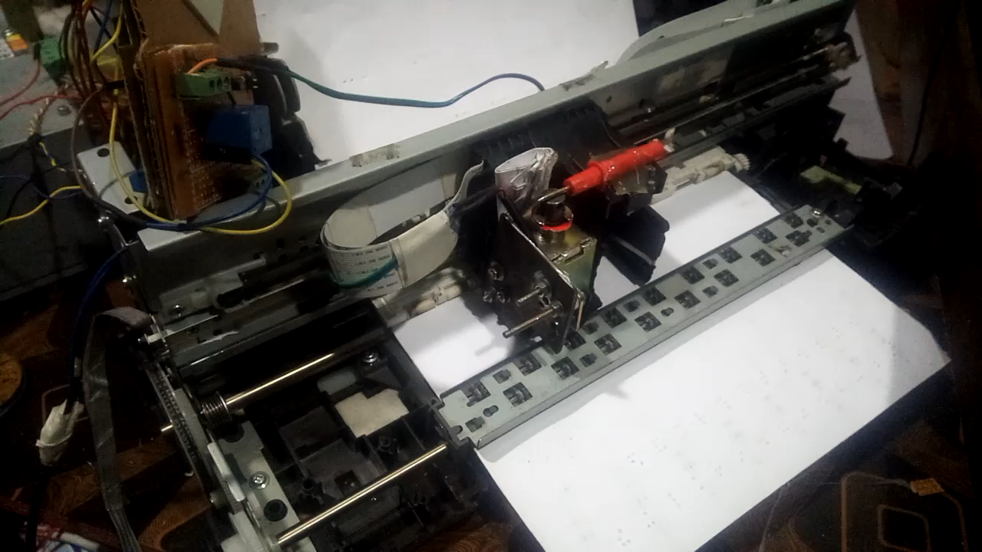
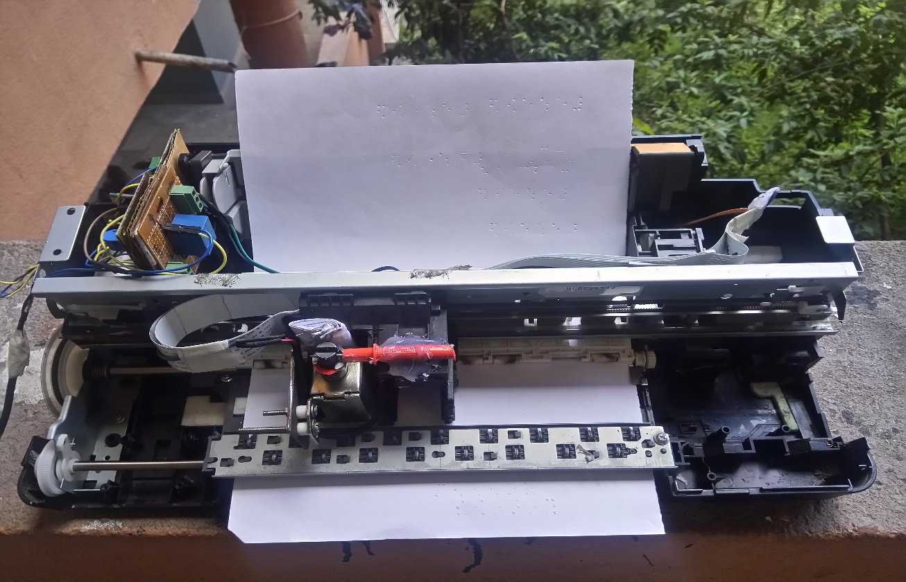
PRESENTING TO
OUR PRODUCT
Set for - Age group 7+

Slide 5
OUR SERVICES
COMFORT ON READING BOOKS
CREATES INDEPENDENCY &
USER-FRIENDLY
EASY AFFORDABILITY & ACCESSIBILITY
STANDALONE
SYSTEM
TEXT TO AUDIO
CONVERT ANY ARTICLE TO BRAILLE
EASY TO USE

Slide 6
MARKET SIZE
<1%
96,000+
61%
Total blind persons in Nepal
Of the blind are employed
of enrolled BPS children have received such text books

Slide 7
REACHING THE CUSTOMERS
THROUGH
NGOs,
INGOs
THROUGH SPECIAL SCHOOLS FOR VISUALLY IMPAIRED PERSON

Slide 8







MARKET ADOPTION

Slide 9
FUTURE VERSIONS OF PRODUCT
.
VOICE CONTROLLED SYSTEM
AUTO-TEACHING MODE
DOWNLOAD E-BOOKS AND PRINT ON BRAILE SCRIPT

Slide 10
LET’S HAVE THE
DEMO OF THE PROTOTYPE

